Slide 1
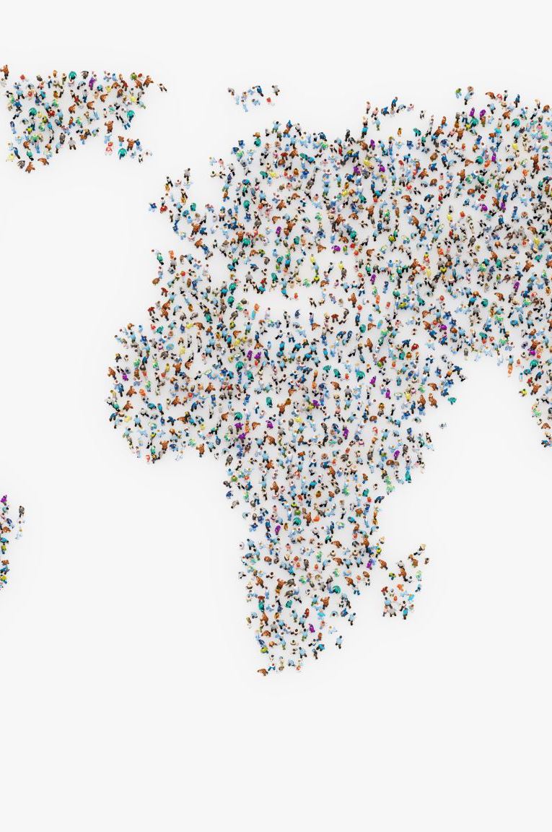

World population analysis

Slide 2
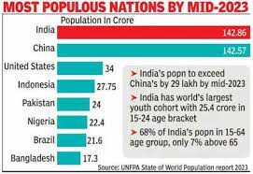
POPULATION OF THE WORLD AND OUR COUNTRY

Slide 3
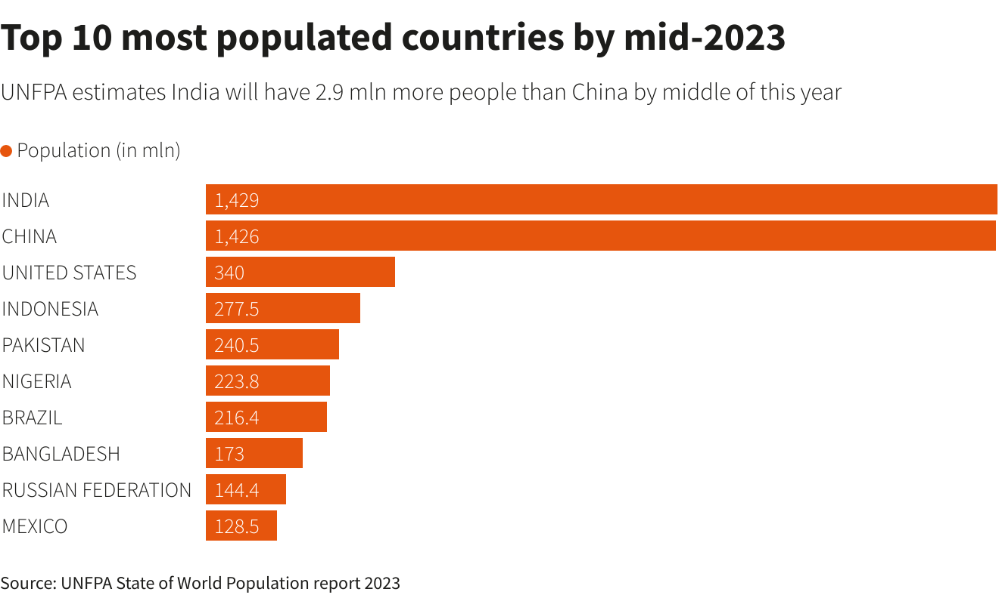
90% of world population lives in the 10% of the world’s land area Present India population is 144 crores.

Slide 4
Factors influencing the distribution of a place
Geographical factors
Economic factors
Availabilitry of water
Landforms
Climate
Soil
Minerals
Urbanization
Industrialisation
Social and cultural factors

Slide 5
SOME BASIC CONCEPTS OF POPULATION GEOGRAPHY
Growth of Population: Change of population in particular area between two points of time is known as growth of population.
Growth Rate of Population: This is the change of population expressed in percentage.
Population growth rate = P(t) - P(t₁)/P(t₁)(t₁₂)
double their population whereas some countries still do not show symptoms of doubling their population.
Natural Growth of Population: This is the population increased by difference between births and deaths in a particular region between two points of time.
Natural Growth Births – Deaths
Actual Growth of Population: This is Births - Deaths + In Migration - Out Migration
Positive Growth of Population: This happens when the birth rate is more than the death rate between two points of time or when people from other countries migrate permanently to a region.
Negative Growth of Population: If the population decreases between two points of time it is known as negative growth of population. It occurs when the birth rate falls below the death rate or people migrate to other countries.

Slide 6
POPULATION GROWTH
The population growth or population change refers to the change in number of inhabitants of a territory during a specific period of time.
This change may be positive as well as negative.
It can be expressed either in terms of absolute numbers or in terms of percentage.
Population change in an area is an important indicator of economic development, social upliftment and historical and cultural background of the region.

Slide 7
COMPONENTS OF POPULATION CHANGE
There are three components of population change - births, deaths and migration.
The crude birth rate (CBR) is expressed as number of live births in a year per thousand of population. It is calculated as:
CBR= (live births during the year / Mid year population of the area) * 1000
Death rate plays an active role in population change. Population growth occurs not only by increasing births rate but also due to decreasing death rate. Crude Death Rate (CDR) is a simple method of measuring mortality of any area.
CDR = (Number of deaths / Estimated mid-year population of that year) * 1000
Mortality rates are affected by the region's demographic structure, social advancement and levels of its economic development.

Slide 8
MIGRATION
people move from one place to another, the place they move from is called the Place of Origin and the place they move to is called the Place of Destination.
The place of origin shows a decrease in population while the population increases in the place of destination.
Migration may be interpreted as a spontaneous effort to achieve a better balance between population and resources.
It may be permanent, temporary or seasonal.
Some name given to Migrants
Immigration: Migrants who move into a new place are called Immigrants.
Emigration: Migrants who move out of a place are called Emigrants.

Slide 9
DOUBLING TIME OF WORLD POPULATION
The time taken to a number of population to be doubled up.
Population growth beyond a certain level leads to problems. Of these the depletion of resources is the most serious.
Population decline indicates that resources that had supported a population earlier are now insufficient to maintain the population.
The deadly HIV/AIDS epidemics in Africa and some parts of the Commonwealth of Independent States (CIS) and Asia have pushed up death rates and reduced average life expectancy. This has slowed down population growth.

Slide 10
POPULATION CONTROL MEASURES
Family planning is the spacing or preventing the birth of children.
Significant factor in limiting population growth and improving women's health.
Free availability of contraceptives and tax disincentives for large families are some of the measures which can help population control.
Thomas Malthus in his theory (1798) stated that the number of people would increase faster than the food supply. Any further increase would result in a population crash caused by famine, disease and war.
The preventive checks are better than the physical checks. For the sustainability of our resources, the world will have to control the rapid population increase.

Slide 11
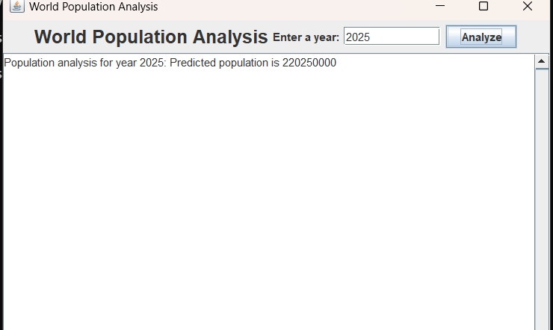
OUTPUT

Slide 12
THANK YOU from NITHIN KANTA

